Slide 1
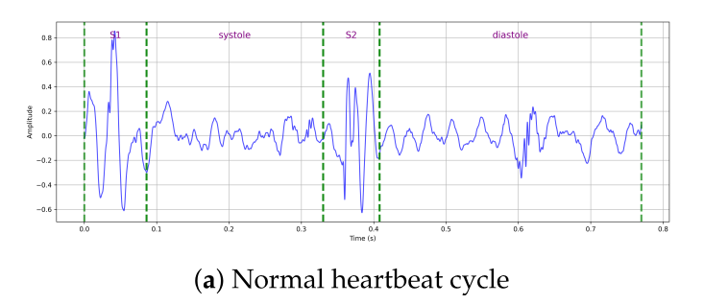
LITERATURE REVIEW
Explainable AI
for Heart Sound
Analysis
Research Methodology
Project — Literature Review
TEAM MEMBERS
PCG / Heart Sounds
Deep Learning
Explainable AI
23BCE078 – Urva Gandhi
23BCE077 – Rakshit Gajnotar
Computer Science Engineering
Nirma University
References: Alrabie & Barnawi (2025) · Althaph & Challa (2025) · Li et al. (2020) · Ren et al. (2021) · Padhy et al. (2025)

Slide 2

Introduction: Heart Sounds & PCG Signals
Acoustic signals generated by the mechanical activity of the heart
What is a PCG Signal?
Phonocardiogram (PCG) signals are digital recordings of heart sounds captured via stethoscope. They contain vital information about cardiac mechanical function, including S1 & S2 sounds and pathological murmurs.
S1 (Lub)
Closure of mitral & tricuspid valves — start of systole
Fig. Normal heartbeat cycle showing S1, systole, S2 & diastole phases
Systole
Ventricular contraction — period between S1 and S2
Abnormalities Indicated by PCG
Valve Stenosis — narrowing of heart valves
S2 (Dub)
Closure of aortic & pulmonary valves — end of systole
Valve Regurgitation — backward blood leakage
Heart Murmurs — turbulent blood flow
Diastole
Ventricular relaxation — period between S2 and next S1
Mitral Valve Prolapse — leaflet displacement
Ref: Alrabie & Barnawi (2025) · Ren et al. (2021)

Slide 3

Importance of Early Detection & Motivation for AI
Why automated analysis is essential for clinical cardiology
#1
17.9M
80%
Cause of Death
Worldwide (CVD)
Annual CVD
Deaths Globally
Deaths Preventable
with Early Diagnosis
Limitations of Traditional Auscultation
Benefits of AI-Based PCG Analysis
✗
Subjective physician interpretation
✓
Consistent & objective predictions
✗
Depends on clinical experience
✓
Processes thousands of recordings
✗
Noise-sensitive — misses subtle murmurs
✓
Detects patterns invisible to human ear
✗
Inter-observer variability
✓
Supports triage in underserved regions
✗
Inaccessible in resource-limited settings
✓
XAI provides clinically interpretable output
Ref: WHO CVD Report · Li et al. (2020) · Chakrabarty et al. (2025)

Slide 4

Datasets & Model Benchmarks
Publicly available PCG datasets and state-of-the-art classification results
Author(s) & Year | Dataset | Classes | Architecture | Key Metric
Li et al. (2020) | PhysioNet/CinC 2016 | 2 (Binary) | Feature Eng. + CNN (GAP) | Accuracy: 86.8%
Ren et al. (2021) | Heart Sounds Shenzhen (HSS) | 3 (Normal, Mild, Severe) | CNN + Global Attention Pooling | UAR: 51.2%
Alrabie & Barnawi (2025) | HeartWave | 4 (Normal, Sys., Dia., Abn.) | ResNet50 + SE + Multi-Head Attention | Acc: 97.3% mIoU: 82.0%
Padhy et al. (2025) | PhysioNet/CinC 2016 | 5 (AS, MR, MS, MVP, Norm.) | X-CBNet (CNN-BiLSTM) | Acc: 99.15% AUC: 0.99
Althaph & Challa (2025) | HeartWave + PhysioNet + others | Multi-class (up to 9) | EHST — Explainable HeartSound Transformer | Acc: 96.7% (HW) Acc: 90.3% (PN)
HeartWave Dataset:
1,353 recordings · Cardiologist-annotated · Detailed S1/Systole/S2/Diastole segmentation · Multiple CVD classes (AS, MR, Tricuspid disorders)
Ref: Li et al. (2020) · Ren et al. (2021) · Alrabie & Barnawi (2025) · Padhy et al. (2025) · Althaph & Challa (2025)

Slide 5

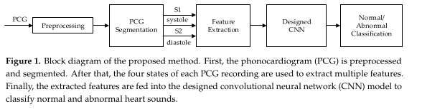
Evolution of Methodologies
From handcrafted features to attention-driven transformer architectures
Pre-2015
2016–18
2019–20
2021–22
2023+
Traditional
Methods
CNN
Models
Hybrid
CNN + RNN
Attention
Mechanisms
Transformer
Models
▶
▶
▶
▶
CNN Pipeline (Li et al., 2020) — Block Diagram
PCG → Preprocessing → Segmentation (S1/Sys/S2/Dia)
Feature extraction from 4 cardiac phases
CNN replaces FC layers with Global Average Pooling
Prevents overfitting on small medical datasets
End-to-end learning from raw spectrograms
Ref: Li et al. (2020) · Ren et al. (2021) · Padhy et al. (2025)

Slide 6

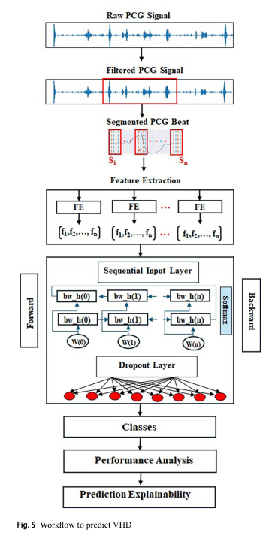
Hybrid CNN–BiLSTM: X-CBNet (Padhy et al., 2025)
Combining spatial feature extraction with temporal sequence modeling
X-CBNet Architecture
Why Hybrid Models?
CNNs:
Extract spatial features from 2D spectrogram representations (local time-frequency patterns)
RNNs (BiLSTM):
Capture temporal dependencies across the sequential S1 → Systole → S2 → Diastole cardiac cycle
Input:
Raw PCG Signal → Butterworth Filter → Segmentation → Feature Extraction
Layers:
CNN Feature Extractor → Sequential BiLSTM layers (Forward + Backward) → Dropout → Softmax
Classes:
5-class: Aortic Stenosis, Mitral Regurgitation, MS, MVP, Normal
Result:
Accuracy 99.15% · AUC 0.99 · State-of-the-art on PhysioNet/CinC 2016
Explainability:
Prediction Explainability module integrated for clinical transparency
Ref: Padhy et al. (2025) — X-CBNet: Explainable Deep Learning for Valvular Disease via PCG. Biomedical Signal Processing and Control.

Slide 7

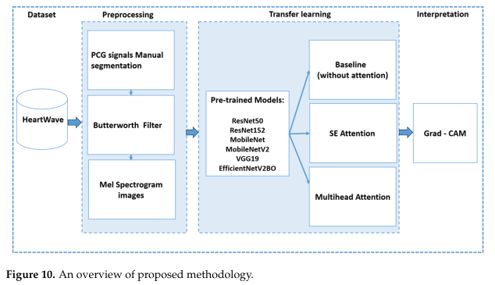
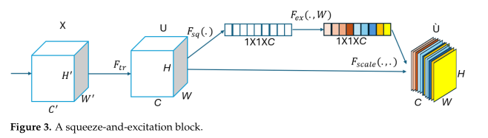
Attention-Based Models (Alrabie & Barnawi, 2025)
SE blocks + Multi-Head Attention integrated with ResNet50 for interpretable classification
Proposed Methodology — Alrabie & Barnawi (2025)
Squeeze-and-Excitation (SE) Block
Dataset:
HeartWave — 1,353 PCG recordings, 4 classes, manual expert segmentation
Preprocessing:
Butterworth filter → Mel spectrogram images
Architecture:
Pre-trained ResNet50 / MobileNet / VGG19 + SE Attention + Multi-Head Attention
XAI Method:
Grad-CAM heatmaps validate attention regions vs. clinical ground-truth
Best Result:
Accuracy 97.3% · mIoU 82.0% — highest interpretability score in literature
Ref: Alrabie & Barnawi (2025) — Bioengineering vol.12 no.6. doi:10.3390/bioengineering12060558

Slide 8

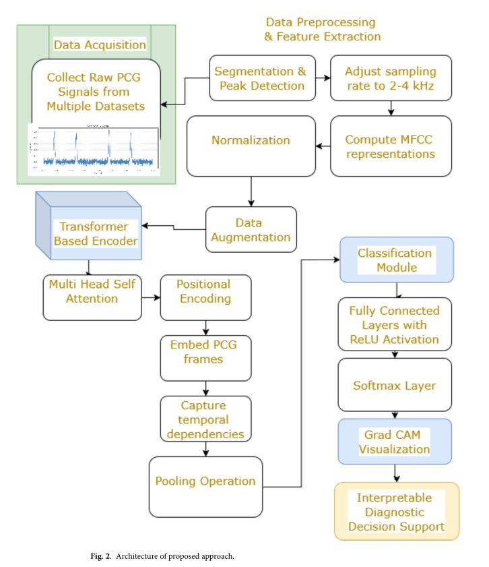
Transformer-Based Models: EHST (Althaph & Challa, 2025)
Explainable HeartSound Transformer with self-attention and Grad-CAM
EHST Architecture — Althaph & Challa (2025)
Why Transformers for PCG?
Self-Attention:
Analyzes all time steps of the cardiac signal simultaneously — no sequential bottleneck
Long-Range Dependencies:
Captures relationships between S1 and S2 events across entire cardiac cycles
Parallel Processing:
Multi-head attention allows focusing on multiple frequency bands simultaneously
Built-in XAI:
Attention weights + Grad-CAM provide direct visual explanation of classification decisions
Ref: Althaph & Challa (2025) — Explainable Attention-Based Deep Learning for Heart Murmur Classification. Scientific Reports.

Slide 9

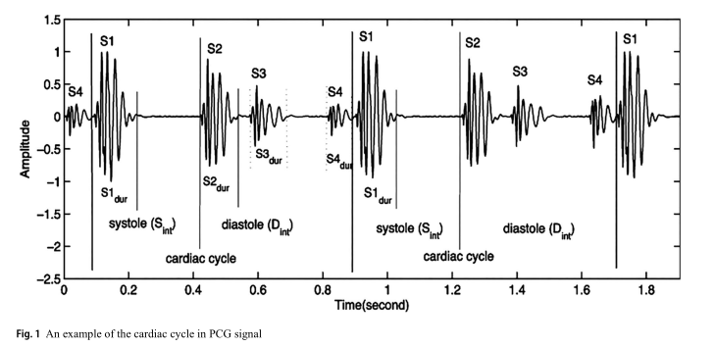
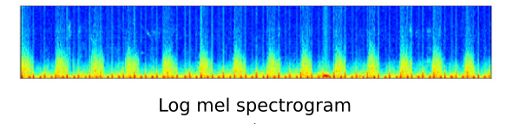
Input Representation of PCG Signals
Preprocessing pipeline and time-frequency feature extraction methods
Raw PCG Signal
Denoising
(4th-order Butterworth IIR)
Normalization
Segmentation
(S1, Sys, S2, Dia)
Feature
Extraction
→
→
→
→
Fig 1. PCG Signal — Cardiac Cycle with Labelled S1, S2, Systole and Diastole Phases
Spectrogram (STFT)
Log-Mel Spectrogram
MFCC
Short-Time Fourier Transform
Perceptually-scaled frequency
Mel-Frequency Cepstral Coefficients
Converts PCG wave to 2D time-frequency image
Hann window for optimal time-frequency trade-off
Time (X-axis) × Frequency (Y-axis) grid
Input to CNN-based classifiers
Compact spectral envelope representation
Maps acoustic frequencies to perceptual scale
Used in Transformer architectures (EHST)
Distinguishes pathological signatures
Ref: Ren et al. (2021) · Li et al. (2020) · Althaph & Challa (2025)

Slide 10

Performance Evaluation Metrics
Dual-metric framework: Predictive accuracy + Interpretability validation
Standard Predictive Metrics
Advanced & Imbalance-Aware Metrics
Accuracy
Precision
AUC-ROC
(TP + TN) / (TP + TN + FP + FN)
TP / (TP + FP)
Area Under ROC Curve
Recall
F1 Score
UAR
TP / (TP + FN)
2×(Precision×Recall)/(P+R)
(1/N) × Σ Recallᵢ
MCC
(TP×TN−FP×FN)/√[(TP+FP)(TP+FN)(TN+FP)(TN+FN)]
Interpretability Metric (mIoU):
IoU = (Prediction ∩ GroundTruth) / (Prediction ∪ GroundTruth) · mIoU = (1/N)×Σ IoUᵢ · Fidelity = (1/N)×Σ I(f(xᵢ)=g(xᵢ))
Ref: Li et al. (2020) · Alrabie & Barnawi (2025) — TP=True Positive, TN=True Negative, FP=False Positive, FN=False Negative

Slide 11

Explainable AI (XAI) Techniques in Heart Sound Analysis
Making deep learning clinically transparent and trustworthy
The XAI Challenge:
Deep learning models are black boxes — clinicians cannot understand why a diagnosis was made. XAI techniques bridge this gap by revealing which cardiac phases or frequency regions drove the prediction, enabling clinical validation.
Grad-CAM
SHAP
LIME
Gradient-weighted Class Activation Mapping
Shapley Additive Explanations
Local Interpretable Model-Agnostic Explanations
How it works:
How it works:
How it works:
Backpropagates class-score gradients to the last convolutional feature map. The gradient magnitudes identify which spatial regions in the spectrogram were most influential in triggering the classification decision.
Game-theoretic approach assigning contribution scores to each input feature across all possible subsets. Provides global & local feature importance rankings consistent with mathematical fairness axioms.
Approximates the complex model locally with a simple interpretable surrogate (linear model) around a single prediction instance, using perturbed input samples.
In PCG Analysis:
In PCG Analysis:
In PCG Analysis:
Highlights WHICH cardiac phases (S2 murmur vs. normal S1) drove the prediction as visual heatmaps
Quantifies HOW MUCH each frequency band or time segment contributed to the abnormal prediction
Explains individual predictions through simplified local models — model-agnostic approach
Ref: Alrabie & Barnawi (2025) · Chakrabarty et al. (2025) · Ramakrishna et al. (2024) · Padhy et al. (2025)

Slide 12

Research Gaps & Open Challenges
Critical barriers to clinical integration of AI heart sound analysis
01
The 'Knowledge Gap' in Visual XAI
Grad-CAM heatmaps highlight where the model looks, but do not translate findings to medical terminology. A pixel highlight does not tell a cardiologist whether the model detected an 'abnormal S2 split' or a 'midsystolic click.'
02
Dataset Limitations & Annotation Scarcity
Publicly available PCG datasets are often small, noisy, or lack detailed annotations. Limited data restricts generalization across diverse clinical environments and patient demographics.
03
Segmentation Reliability in Pathological PCGs
Automated segmentation (e.g., HMM-based) is highly error-prone in the presence of pathological murmurs. Manual expert segmentation vastly improves XAI reliability but is resource-intensive and unscalable.
04
Single-Label vs. Multi-Label Clinical Reality
Most research treats VHD as a single-label problem. In reality, patients frequently present with concurrent conditions (e.g., regurgitation + stenosis simultaneously) — a gap future architectures must address.
05
Real-World Noise & Hardware Heterogeneity (Domain Shift)
Models trained on one recording device suffer significant 'domain shift' when applied to different digital stethoscopes, each with unique sensor sensitivities and frequency response characteristics.
Ref: Alrabie & Barnawi (2025) · Padhy et al. (2025) · Chakrabarty et al. (2025)

Slide 13

Conclusion & Future Research Directions
Summary of literature findings and next steps for clinical-grade AI
Key Observations from Literature
Traditional → Deep Learning:
CNNs with GAP outperform handcrafted SVM/HMM approaches, achieving 86.8%+ on standard benchmarks (Li et al., 2020)
Hybrid CNN-BiLSTM:
X-CBNet integrates spatial feature extraction with temporal sequence modeling, achieving 99.15% accuracy on 5-class valvular disease (Padhy et al., 2025)
Attention Mechanisms:
SE blocks + Multi-Head Attention with ResNet50 achieves 97.3% accuracy and mIoU 82.0% — highest interpretability alignment in literature (Alrabie & Barnawi, 2025)
Transformer Architecture:
EHST achieves 96.7% accuracy on HeartWave and 90.3% on PhysioNet while providing XAI transparency via Grad-CAM (Althaph & Challa, 2025)
Future Research Directions
Larger annotated datasets with diverse patient demographics and multi-site clinical recordings
Improved automated segmentation algorithms robust to pathological murmurs and noise
Multimodal analysis: Combining PCG + ECG signals for comprehensive cardiac profiling
Clinical validation studies verifying AI explanations against expert cardiologist annotations
Ref: Alrabie & Barnawi (2025) · Althaph & Challa (2025) · Padhy et al. (2025) · Li et al. (2020)

Slide 14
References
1. Alrabie & Barnawi (2025). Are AI Models Listening Like Cardiologists? Bioengineering 12(6). doi:10.3390/bioengineering12060558
6. Li et al. (2020). Classification of Heart Sounds Using CNN with Global Average Pooling. IEEE Access. ieeexplore.ieee.org/9069940
2. Althaph & Challa (2025). Explainable Attention-Based Deep Learning for Heart Murmurs via PCG. Scientific Reports. doi:10.1038/s41598-025-21971-x
7. Padhy et al. (2025). X-CBNet: Explainable CNN-BiLSTM for Valvular Disorder via PCG. Biomed. Signal Proc. & Control. doi:10.1016/j.bspc.2025.105336
3. Ramakrishna et al. (2024). Explainable ML for Heart Sound Abnormality Detection. IJECE 36(2):846–853. doi:10.11591/ijeecs.v36.i2
8. PhysioNet/CinC Challenge 2016 Dataset. physionet.org/content/challenge-2016/1.0.0/
4. Chakrabarty et al. (2025). Can We Trust AI With Our Ears? Cross-Domain Explainability in Audio AI. IEEE Access. doi:10.1109/ACCESS.2025.3622161
9. CirCor DigiScope Phonocardiogram Dataset (2022). physionet.org/content/circor-heart-sound/1.0.3/
5. Ren et al. (2021). Heart Sound Classification via Deep Representation Learning + Attention. IEEE Access. ieeexplore.ieee.org/9334386
10. HeartWave Dataset (referenced in Alrabie & Barnawi, 2025). doi:10.3390/bioengineering12060558

